Slide 1

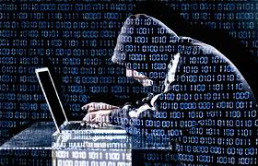
Council Data Breaches and Cyber CRIME
Brian Brookes – Risk Manager, BHIB Insurance Brokers

Slide 2
Cybercrime THE FACTS
Fraud and cyber crime are now the country's most common offences
Costs the UK Economy in excess of £27bn per year
An individual or Business now 50 times more likely to be a victim of fraud via the computer than a physical Crime
Government figures show that over 50% of businesses are unprepared
Any Business is a potential target

Slide 3
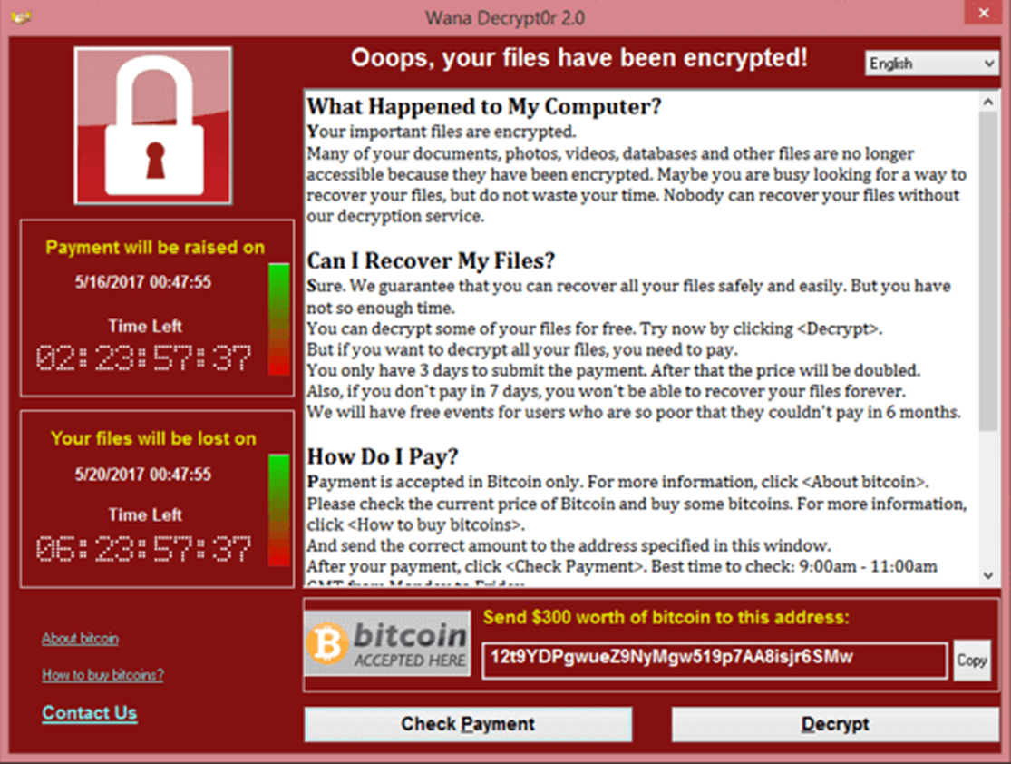
RANSOMWARE
Demands a Ransom payment
Encrypts your Files
You might not get your files back
DON’T Pay the Ransom
Report to Actionfraud on 0300 123 2040

Slide 4
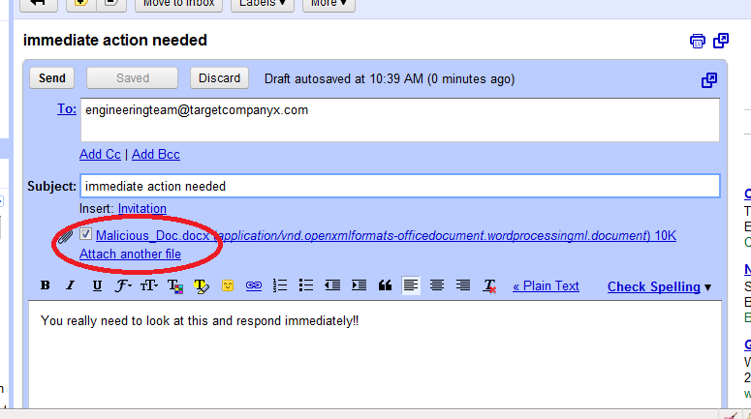
PHISHING or SPEAR PHISHIING
Phishing Email Received = Link = Fake Website = Malware & Credential Stealing
Phishing emails are not directly targeted at an individual
Spear Phishing attempts are highly targeted using Previous Research

Slide 5
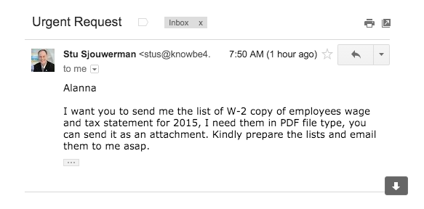
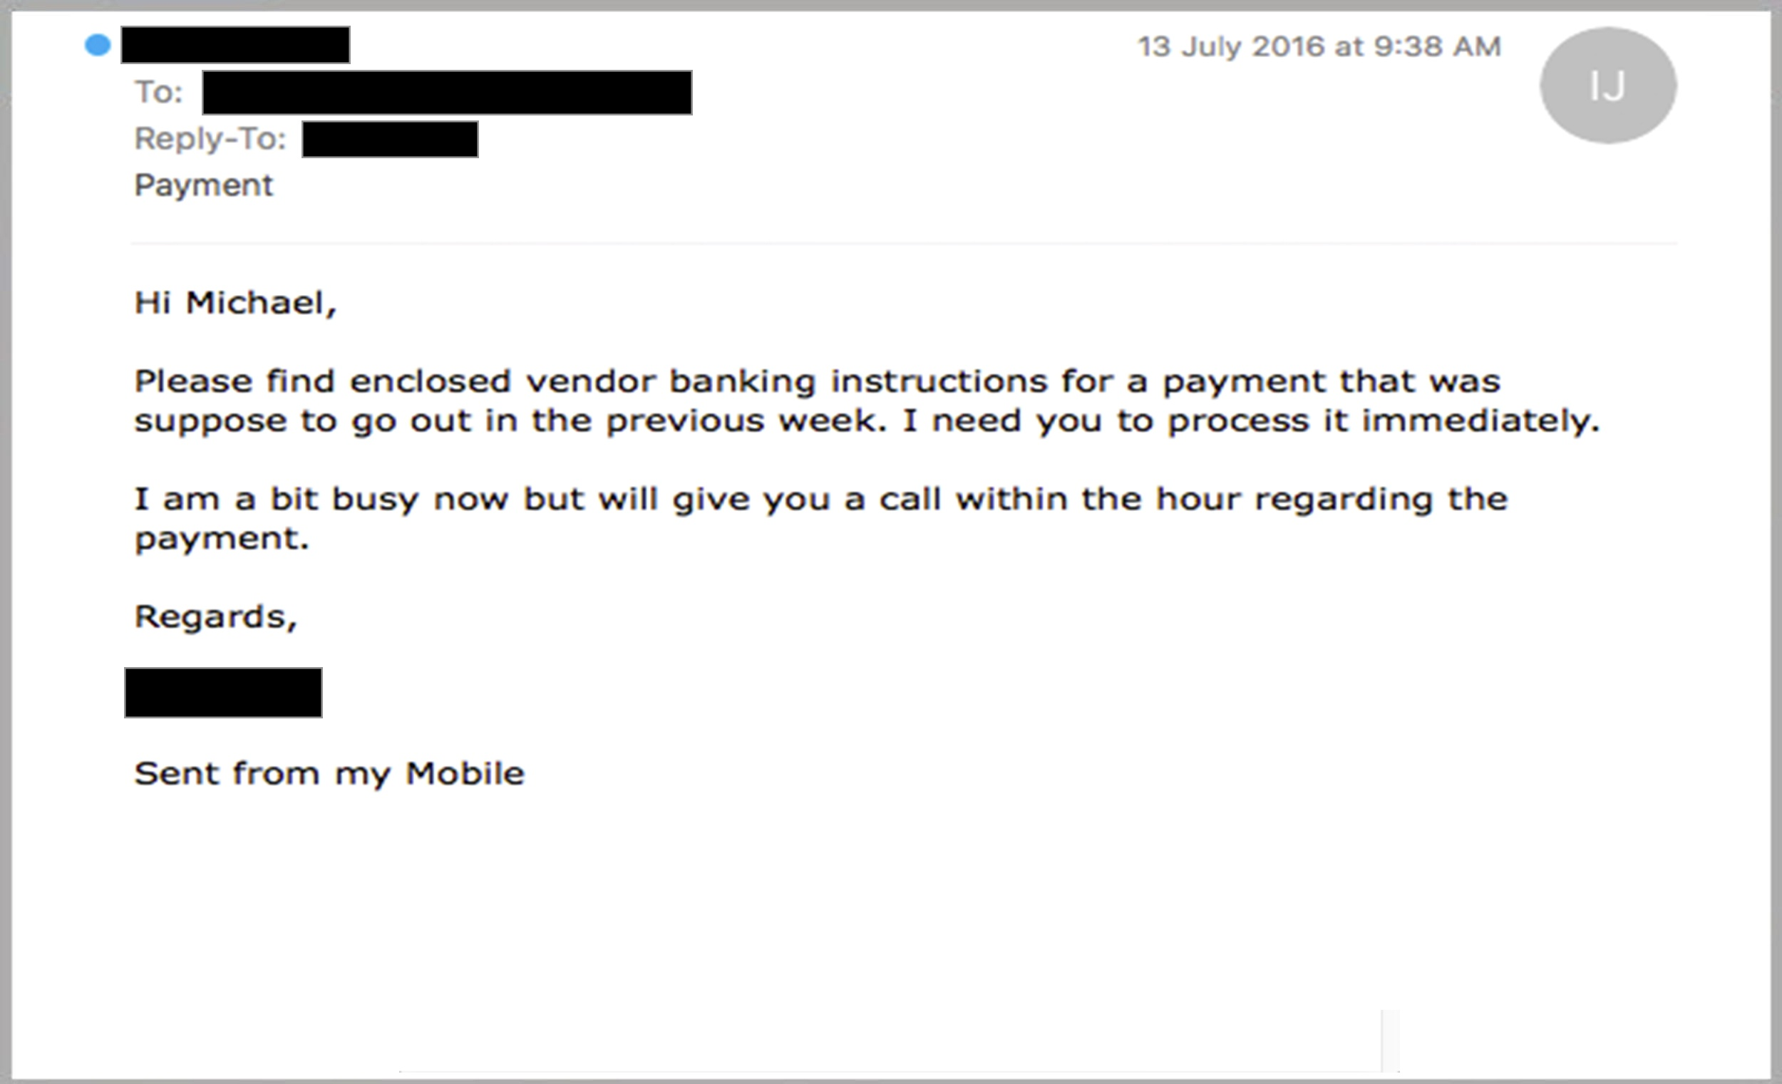
CEO FRAUD
“Please transfer £40,000 to this account, its really urgent before 12pm please” From CEO
Extremely difficult to get your money back
Verify & Check !

Slide 6
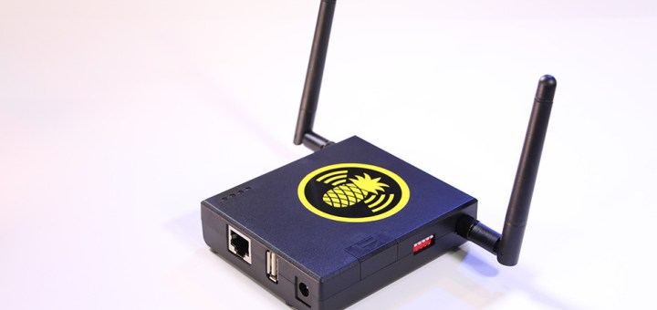
Other THREATS
  DDOS (Denial of Service) Attack
  Rogue Employees.
  Negligent Employees
  Telephone Scams

Slide 7
Recent ICO fines
Nottinghamshire County Council fined £70,000 for leaving vulnerable people’s personal information exposed online for 5 years.
£70,000 fine for London Borough of Islington for failing to keep 89,000 peoples information secure on its parking ticket system website.
Gloucester City Council fined £100,000 after a cyber attacker accessed council employees sensitive personal information.

Slide 8
GDPR
Mandatory Notification – The ICO must be notified of any data breach with 72 hours of the breach being discovered
Fines of up to 4% of worldwide turnover or EUR 20,000,000, whichever is higher.
More Rights For Data Subjects i.e. Portability, erasure and objections to profiling
Compensation for `Non Material` damage` has been added - i.e. Distress Claims
Talk Talk fined £400,000 in 2016.
In May 2018, after GDPR applied, this could have been £73million.

Slide 9
How can you protect your Business
User education and awareness
Information risk management regime and Incident management
Secure configuration
Network security
Managing user privileges
Malware protection
Monitoring
Removable media controls
Home and mobile working policy
Vet Third Party Suppliers. i.e. IT Supplier, cloud providers
Consider Insurance

Slide 10
How secure is your favourite password?
Betterbuys.com gave the following examples of the time it might take a hacker to crack a password in 2018:
council 0.22 milliseconds
Council 18 hours 58 minutes 27 seconds
Council1 5 months 2 weeks 3 days
CouncilNo1 1 millennia 7 centuries 6 decades
!Council98! 8414 millennia 5 decades 7 years
!Council98!No1 Infinity

Slide 11
Cyber Liability Insurance
FIRST PARTY
Access to Industry experts
Data breach legal expenses
Reputational loss
Forensic costs
Repair cost
Extortion Loss of business income & Increased costs
Data breach fines and penalties
Data breach notification expenses
Credit/identity theft monitoring expenses

Slide 12
Cyber Liability Insurance
THIRD PARTY
Claims for Direct Financial Loss
Privacy Claims for breach of Personal Identifiable Information
Corruption of third party data by malicious code
Defamation, Libel or Slander
Negligent transmission of a virus delivered via your network
Distress Claims

Slide 13
Questions?

